Slide 1
Task 4 – Dashboard Design Data Analyst Internship
HARINI SHANMUGAVEL
25.4.2025

Slide 2
Dataset Summary
Dataset: sales_data
Columns: buyer_age, buyer_location, date, product_name, sales_in_amount, sales_in_quantity
Goal: Visualize customer behavior and sales trends using Power BI

Slide 3
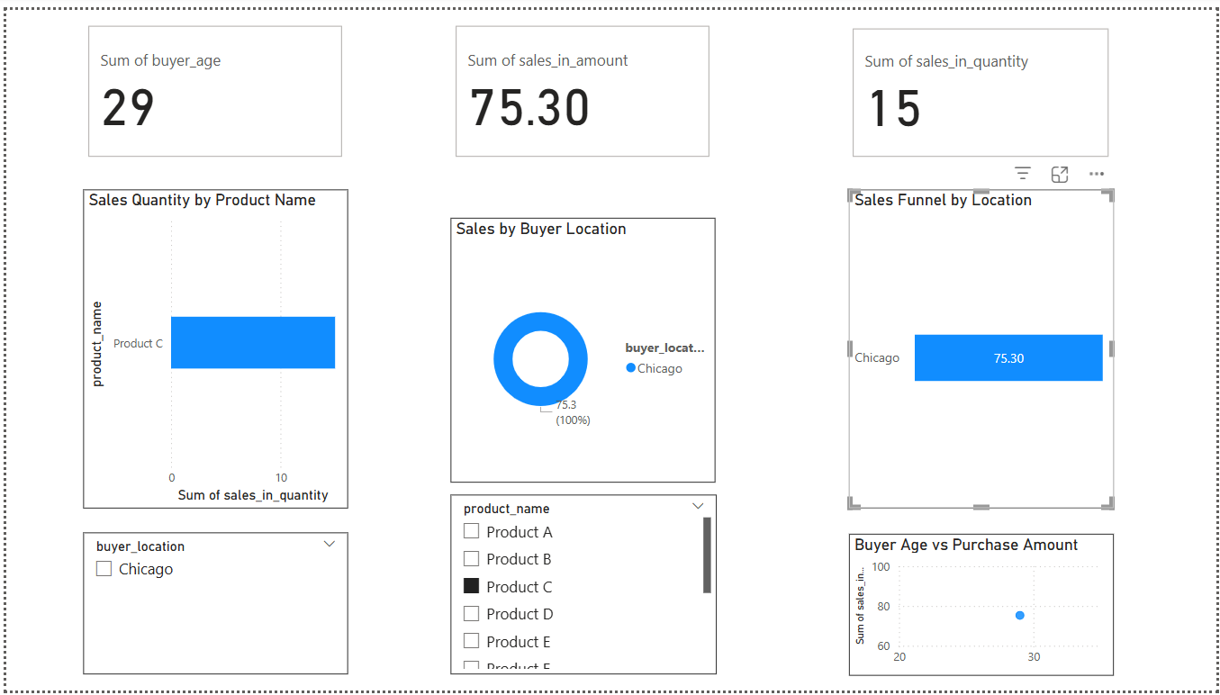
Dashboard Summary
Main Visuals:
- Donut Chart – Sales by Location
- Bar Chart – Quantity Sold per Product
- Scatter Plot – Buyer Age vs Sales
- Funnel Chart – Sales by Location
Filters Used:
- Location, Product Name, Buyer Age (optional)
KPIs:
- Total Sales Amount
- Units Sold
- Avg Buyer Age

Slide 4
Key Insights
- Chicago leads in revenue
- Product c is most popular
- Buyers aged 30–40 spend more

Slide 5
Tools & Conclusion
Tools:
- Power BI
- Excel (CSV)
- GitHub
Conclusion:
This dashboard provides insights into buyer behavior and product sales using non-date visuals, enabling better decisions based on location and age patterns.

